Slide 1
Red Hat
OpenShift Container Platform
Overview
Chuck Svoboda
OpenShift Practice Lead, Public Sector
@CharlesRishard

Slide 2
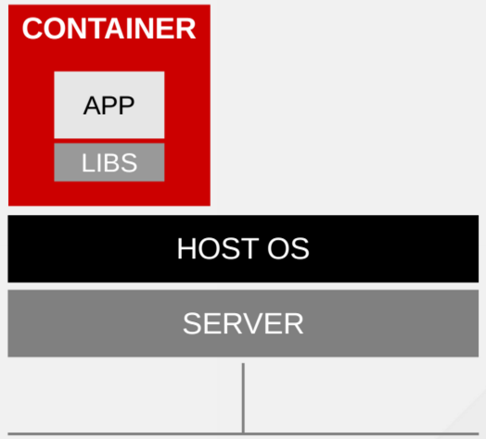
What Are Containers
Software packaging concept that typically includes an application and all of its runtime dependencies.
Easy to deploy and portable across host systems
Isolates applications on a host operating system
In RHEL, this is done through:
Control Groups (cgroups)
Kernel namespaces
SELinux, sVirt
rkt, docker, etc
Notes:
Alight, before we dive into OpenShift, it’s important we describe what containers are, what DevOps is, and how this all relates to the open source ecosystem Red Hat is a big part of.
So, what are containers? Containers are a software concept where an application and its dependencies are packaged in an immutable vessel to perform some sort of workload… And in most cases, run with a very small resource footprint.

Slide 3
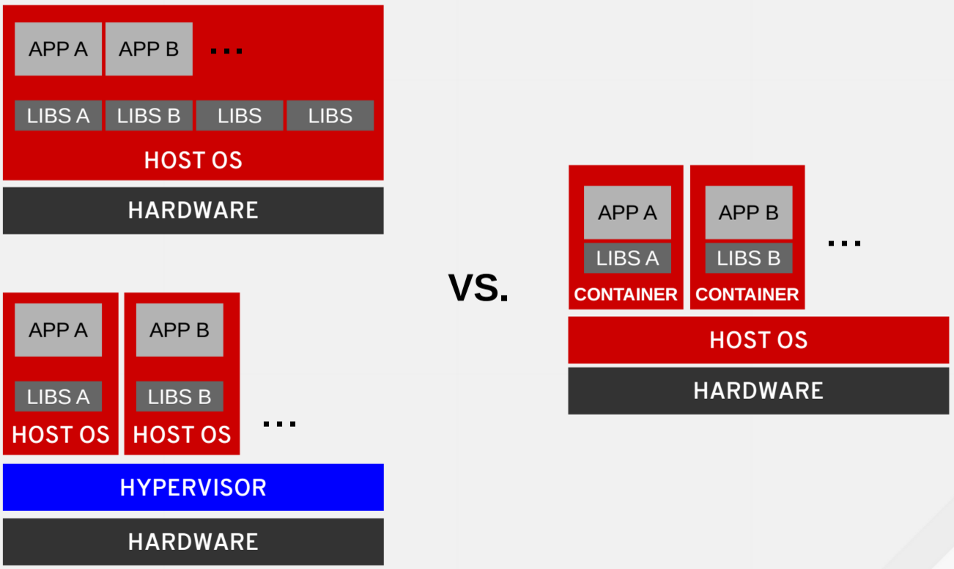
Bare Metal vs VMs vs Containers
Notes:
In a lot of cases, it’s easiest to compare bare metal to virtual machines and then to containerized workloads… And this diagram does a pretty good job at demonstrating it with the absence of a hypervisor and sharing a host operating system between containers, which by design, are completely isolated from each other on this tier up.
And it’s great to understand what containers are because frankly, you cannot have much of a conversation about IT modernization, DevOps, or platform as a service without talking about them. Right now, there is a ton of buzz in this area… in fact I kind of joke that if you want to get a talk accepted at a conference, you just put container in the title and you’re in.
As such, with all this buzz, there is a ton of misperception. In fact...

Slide 4
What is your container strategy?
Notes:
So first things first… I am sure most of you on the call have been asked this, “What is your container strategy” as if having a container strategy is 100% necessary to modernizing apps and doing cool stuff with “air quotes” here, “cloud native”.

Slide 5

Notes:
And usually we hear, “docker”... Not knowing when they say it if they mean the “little d” docker the container or the ”Big D” Docker Inc. the company. And yes, there is a huge difference, but that’s for another time.
That being said…

Slide 6
Let’s get one thing clear
Containers don’t matter
Notes:
Let’s get one thing clear, containers really don’t even matter!

Slide 7
So what does matter?
Notes:
No doubt, you’re probably going “What?!” “Chuck, you’re nuts”... Containers are great, everybody wants them, and everybody is using them to solve the toughest of their IT challenges… It’s like, I’ve got an app dev, problem so I’ll rub some containers on it, and it will solve everything for me. And every conference I go to tells me containers are the hottest thing since coffee.
But alright then, if containers don’t matter, than what the heck does?

Slide 8
The utility of containers
Notes:
What matters are the things that the container enable teams to do!
It’s the utility of the container that matter...

Slide 9
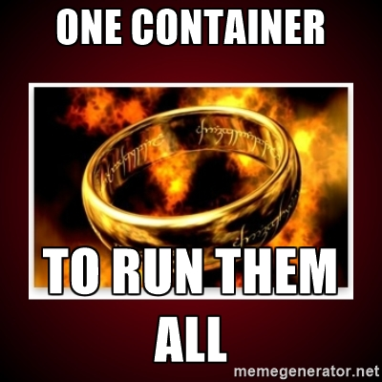

Notes:
And the utility of what containers enable you to do, is a ton of really cool stuff… to run a huge number of different workloads.
And the container format we use is founded in the Open Container Initiative, aka ”OCI”, which is a community of container thought leaders building standards around runC. This includes ”little d” docker, CoreOS rkt, and more to come.

Slide 10
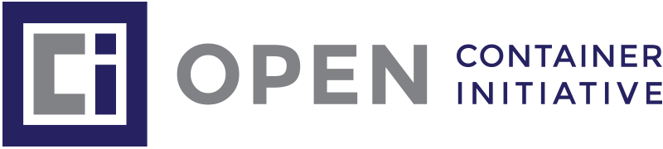

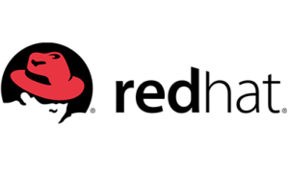


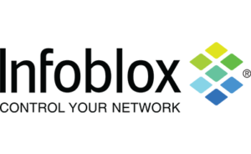
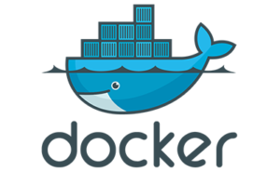
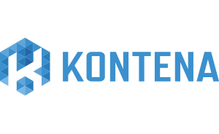
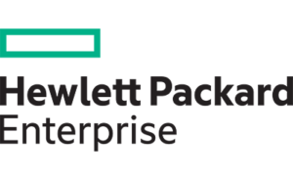
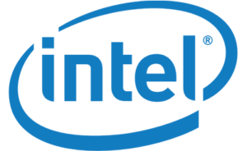

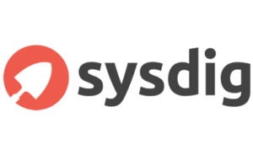
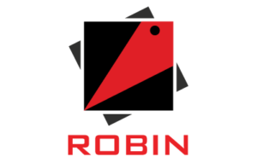
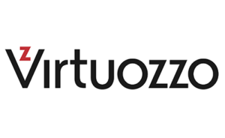
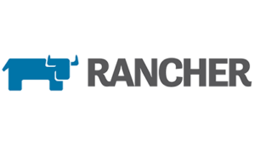


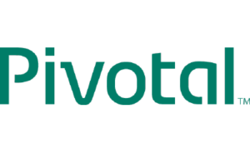
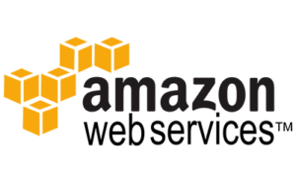
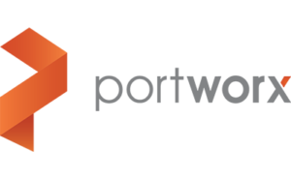

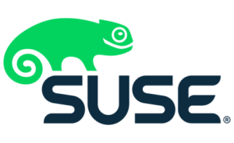
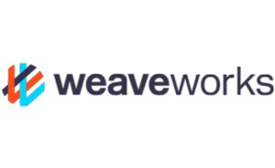


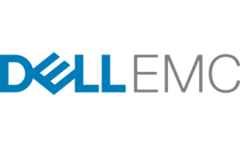
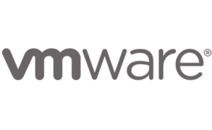
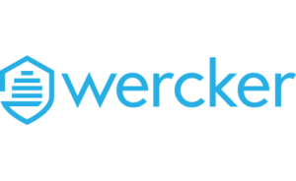

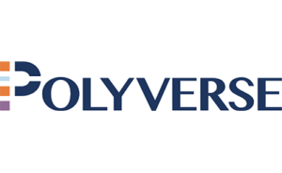
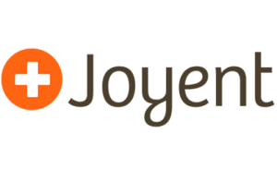
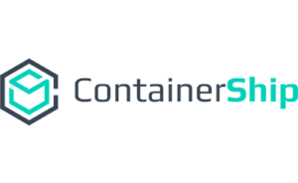
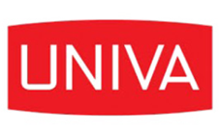

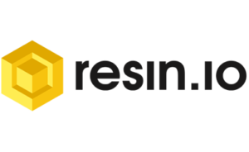
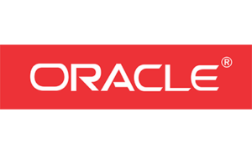
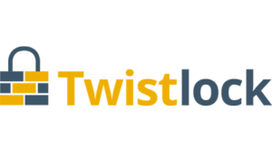
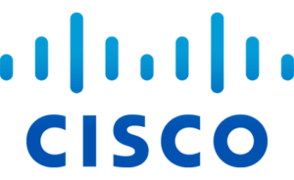

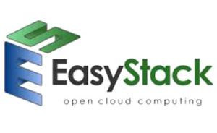
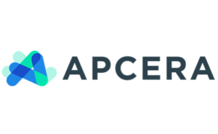



Slide 11
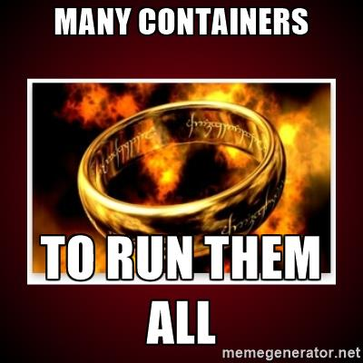
Notes:
And the utility of what containers enable you to do, is a ton of really cool stuff… to run a huge number of different workloads.
And the container format we use is founded in the Open Container Initiative, aka ”OCI”, which is a community of container thought leaders building standards around runC. This includes ”little d” docker, CoreOS rkt, and more to come.

Slide 12
And one other thing
Containers are boring
and they should be
Notes:
But all that being said, containers are boring… and they should be.
This is to say the container itself, is just a vessel for workloads.
[MODERATOR] "So why is important that containers remain boring?”
Because containers are just new school infrastructure for apps and services. They just need to work. Things that just need to work shouldn’t be exciting and such so developers can just focus on delivering great apps and operators can just define how they run. Containers need to be prescribed in such a way they can be automated and abstracted away so IT shops can focus on delivering business value, which is after all, their mission.

Slide 13
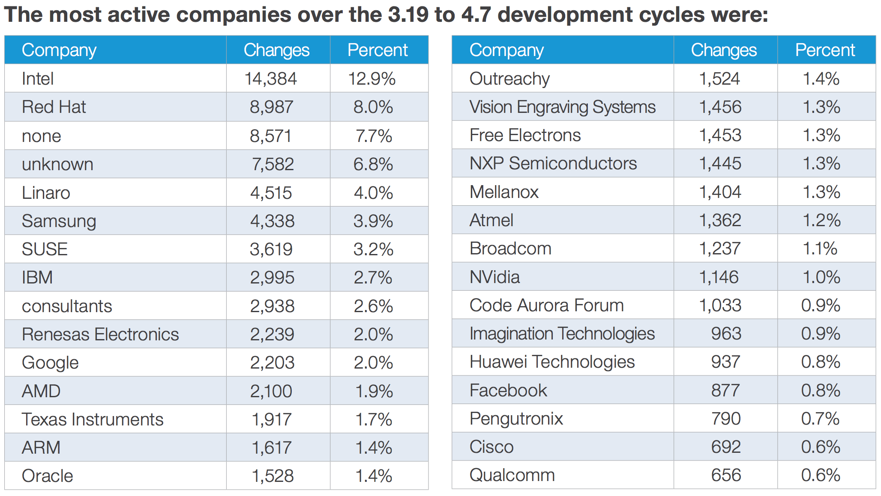
Containers are Boring Because of These Folks
RHT Knows a Thing or Two About Containers
https://www.linux.com/publications/linux-kernel-development-how-fast-it-going-who-doing-it-what-they-are-doing-and-who-5
Notes:
But that’s not to say just because containers should be boring, that it’s not important for the container infrastructure to be done right. And that infrastructure in the Linux world, is the Linux Kernel.
And this is super important to understand because it’s only through the primitives exposed by the Linux kernel that Linux containerization can be done. And this is nothing new… heck, containerization like BSD Jails and Solaris Zones have been around for a decade.
As such, if you look at this chart, you’ll see a list of companies dedicating a huge amount of resources, in the form of contributions, to tackle the toughest challenges in the Linux kernel, enabling this whole evolution of the container ecosystem.
You cannot do Linux containers without the Linux kernel, and the companies on this list know it best. When betting on a company to deliver your container infrastructure, these companies are a safe bet.
[CLICK]
Especially, and if I may toot our own horn, Red Hat.

Slide 14
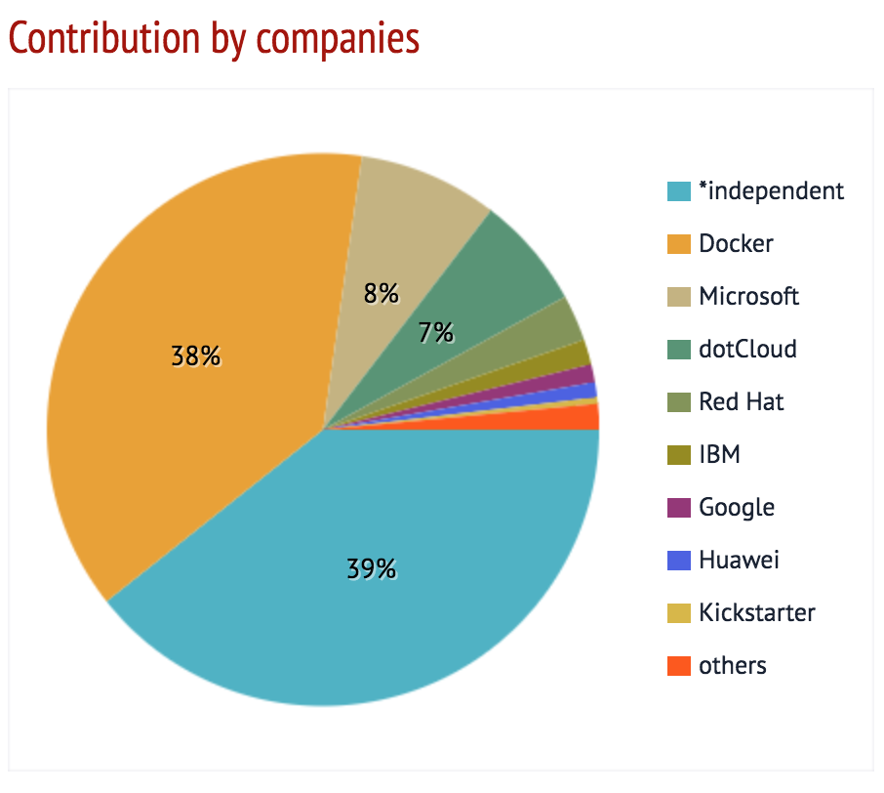
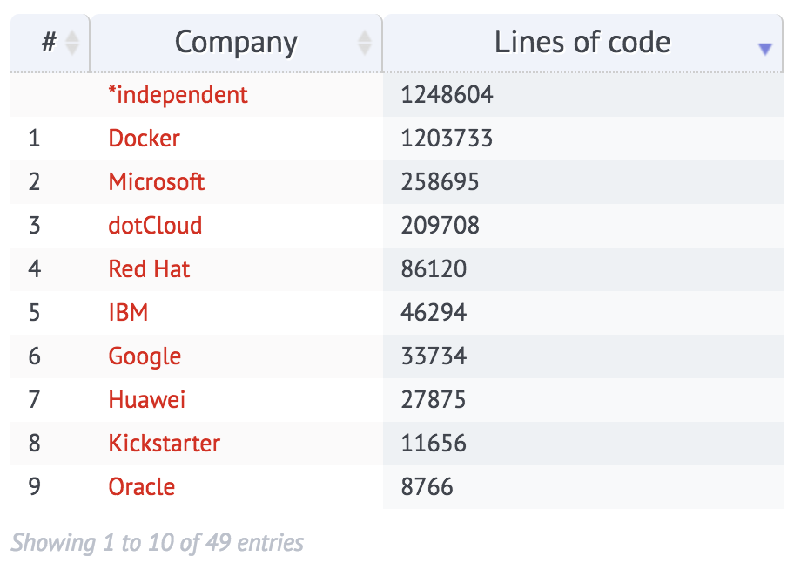
And that ”little d” docker Thing Too
http://stackalytics.com/?release=all&project_type=docker-group&metric=loc&module=docker
Notes:
But I am not oblivious that you cannot talk Linux containers without talking about “little d” docker. Funny enough, a lot of folks talk docker being synonymous with containers, as ”little d” docker being the “kleenex of containers”
So to toot our horn again, Red Hat is the 2nd most active contributor to docker behind microsoft… no, dotCloud doesn’t count because that was what “big D” Docker Inc was before.
And Red Hat use to be number one behind Docker Inc. It’s not that we have tapered off in contributions, it’s the opposite in fact, it’s that the new “Microsoft Loves Linux” Microsoft has invested so much to bring containers to Windows Server. And in the open-source world, this is a GREAT thing and we are happy to have them.

Slide 15
Containers are an ingredient, not a solution
but they are a great ingredient
Notes:
So rolling right in, for a matter of introduction, my name is Chuck Svoboda and I am the OpenShift Practice Lead for public sector at Red Hat.
On my background, funny enough, I started out super passionate in journalism, and even decided on my college because of this, to make a career out of photography.
Which, I basically dropped before even attending, entering the school of engineering at mizzou, resulting in me being a software engineer by trade with over 10 years of app dev experience, including a ton of .Net experience, which is kind of funny since I’m a Red Hatter now.
I also have a few years of big label consulting in my background, so I’ve seen quite the wide swath of organizational challenges and experiences, especially in IT, which is probably one of the reasons I love talking about things like DevOps, PaaS, and other emerging, next gen technologies. I really love this stuff!
And the stuff we’re going to talk about is a bit in the container ecosystem, how to define DevOps, Kubernetes, microservices, and how Red Hat OpenShift ties this all together. Lastly, we’ll wrap on organizational change and community.
Lastly, before we jump in, this is my deck… champagne ideas with a beer graphics budget…

Slide 16


Slide 17
Let’s talk
DevOps
Breaking down silos between developers and operators
Continuous Integration
Working in the cloud
Microservices
Developers deploying to production
Moving fast
Continuous Delivery
Cloud Native
Developing in node.js and ruby
Notes:
So now that we’ve level set on containers a bit, let’s switch gears to defining out DevOps, which honestly, is probably one of the most nebulous and misunderstood concepts in the IT community.
I’ve posted up here, quite a few definitions I’ve heard across the industry and from customers… Probably the most popular one being, the portmanteau of bringing developers and operators closer together. Other things we commonly hear is developers deploying to productions, developing agily on next gen frameworks and languages like node and ruby, and all things microservices.
And we hear a lot of customers say “we’re just not ready for devops!” No way can developers deploy to production, etc etc… And a lot of customers are probably right that they’re not ready to do some of these things.
But what’s important to understand, is that everything on this slide, while related to DevOps, are just possible symptoms of running in the state of DevOps.

Slide 18
DevOps
The cultural aspect of concentrating on business results rather than technical details.
* Courtesy of Matthias Marschall, CTO at Stylight
Notes:
And what is the state of DevOps? It’s this-> The aspect of concentrating on business results rather than technical details.
Who would not want to do this? Focus on the output of a button click rather than all the things that actually make it work, reliable, and scale.

Slide 19
>
Business Results
Technical Details
Notes:
To simplify it to a formula… it’s this!

Slide 20
What are some of those
Technical Details
Containers
Scaling
Storage
Telemetry
Operating Systems
High Availability
Log Aggregation
RBAC
Image Management
Metrics
Security
Alerting
Deployment Topologies
Patching
Self Healing
Monitoring
VMs
App Servers
Networking
Configuration Management
Routing
Notes:
And what are some of these technical details? Well, its a great blend of infrastructure and application level concerns like VMs, security, app servers, logging, and more and more… all the stuff that is not really functional details you’d find in a requirements doc, written by a business unit.
And this even includes containers themselves.
[MODERATOR] "Are you saying technical details are not important at all?"
No, not at all. These technical details are very important, but should be boring and directly hidden… Automated and managed by a platform. Again, this way IT shops can focus on delivering great business value rather than managing all this minutia.

Slide 21
Platform
Management
Container
Notes:
Considering the tech details are not something you should concentrate on, but are still very important and yet should be boring…
Well, I’d like to talk about what I call the DevOps Wedding cake...

Slide 22
Platform
Business
Results
Management
Technical
Details
Container
Notes:
Where we can apply the definition of DevOps… starting with the container layer for workloads and an management layer to orchestrate and schedule all of these containerized workloads, you will be be building.
But the important thing to really understand here, is that just using a container or management tier does not enable DevOps. It does not enable you to focus on the business results! For that, you need a platform to deliver.

Slide 23

Notes:
And we stress this, to prevent folks from attacking the wrong layer… far too often folks do this, just working with containers and/or a cobbled together orchestration tier and end up with pretty messy results… which is what we see a lot of organizations in containerville, DIY PaaS, built on adhoc components and automation resulting in something sloppy and very much unmaintainable

Slide 24
Notes:
Gotta do this… union rules

Slide 25
OpenShift
Business
Results
Kubernetes
Technical
Details
OCI
* Check the SLOC for these projects on Stackalytics et al
Notes:
So this is where OpenShift comes in.
And what this looks like in our world, starts with Open Container Initiative, aka OCI, compatible specs as the container, which is now “little ‘d’ docker containers, but soon to be rkt and anything else coming that is OCI compatible. An uber portable spec that everyone, and I mean everyone is looking at to run an incredible swath of workloads… including things I would have never thought of… heck, we even have an engineer that’s been demoing COBOL in a container, on OpenShift.
Next, is Kubernetes, an enterprise grade, web-scale container management and orchestration layer, open-sourced by Google, who knows a thing or two about running containers, right?… in fact, they stand up and destroy about two billion containers a week.
And tying all of this goodness together is Red Hat OpenShift, the enterprise-ready Kubernetes easy button abstraction layer to these awesome technologies so your developers focus on building great code and your operators focus on managing these tiers through defining and delivering hardened and centralized policy, delivered by the platform through the whole of the infrastructure, rather than a ton of manual, error prone minutia.
And that’s how OpenShift plays into and enables DevOps… by enabling you to focus on the business results rather than the technical details, of these super-power ingredients.
But before we dive into OpenShift, I want to talk a bit about the awesomeness of Kubernetes.

Slide 26
What is your container strategy?
Notes:
So back to the old “what is your container strategy question.”
Hopefully I convinced you a bit just working around an airquote “container strategy” isn’t enough. They’re boring and a utility and don’t enable much on their own.

Slide 27
What is your Kubernetes strategy?
Notes:
What folks should be asking is “what is your Kubernetes strategy?”
Kubernetes is exciting and is where you really start to extract the business value out of running a containerized environment.

Slide 28
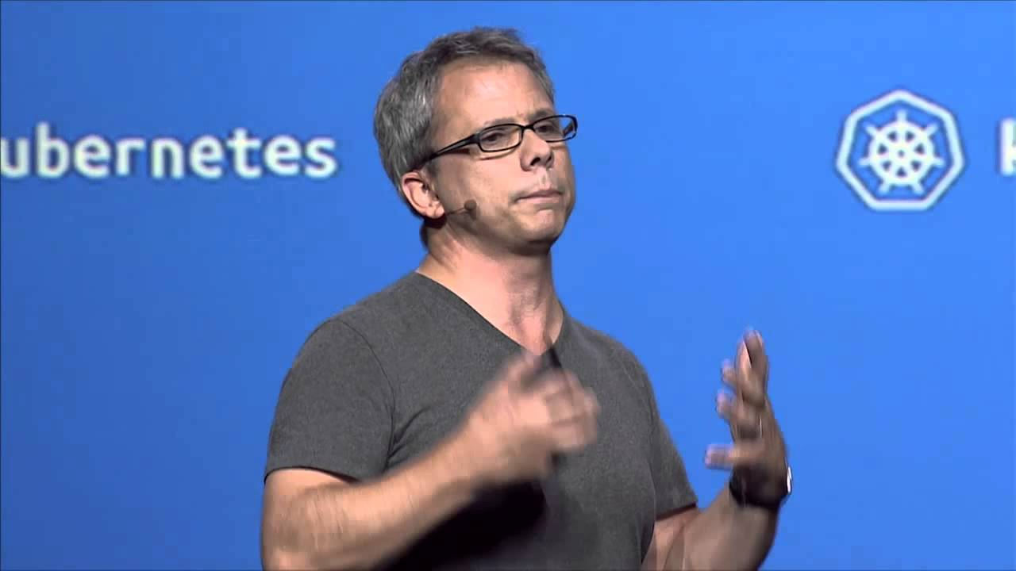
“When you spend 15 years working on cloud engineering and cloud infrastructure you
learn what works and what doesn't.”
“Kubernetes is us taking the learnings of what works and what doesn't in managing production containers at scale and doing it in the open source.”
-Greg DeMichillie
Director of Product Management
Google Cloud Platform
https://www.youtube.com/watch?v=6a2Nirr8cI0
Notes:
And this is possible because what Kubernetes was founded in is 15 years or so of running cloud infrastructure by Google.
They’ve figured out what works in container management, and probably more importantly, what does not!
I remember watching the live stream of Greg DeMichullie at the Kuberentes GA launch back in July of 2015 and thinking on how important Google’s experience in managing containers at scale is and the fact that Google open-sourced this project to get help from the community making it even better.

Slide 29
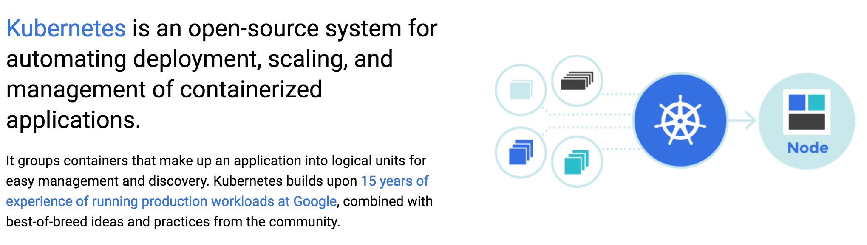
Kubernetes 101
http://queue.acm.org/detail.cfm?id=2898444
Notes:
And stressing Google’s experience in this providing a hardened way to automate container deployment, scaling, and management. A lot of experience was gifted to the community. If you check out the link here in the lower left, it’s a great paper on talking what Google learned from running their own Borg and Omega container management solutions, baking those lessons learned into Kube.

Slide 30
Container Management is TOUGH!
Notes:
Even so, Google understands that they cannot do Kubernetes all on their own. Container management is a super tough problem to solve. And as I mentioned earlier, Google understands this and opensourced it.

Slide 31



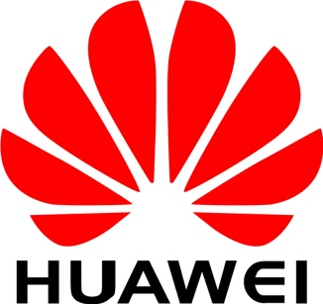
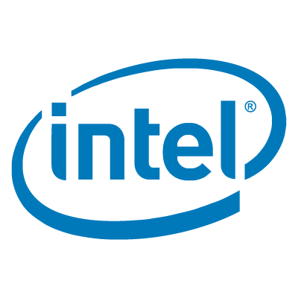

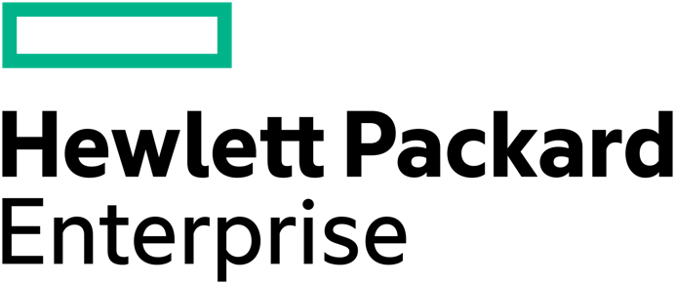

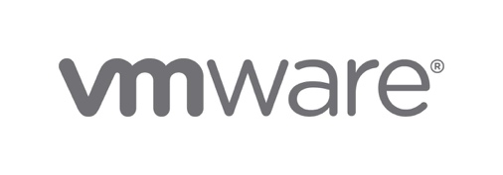
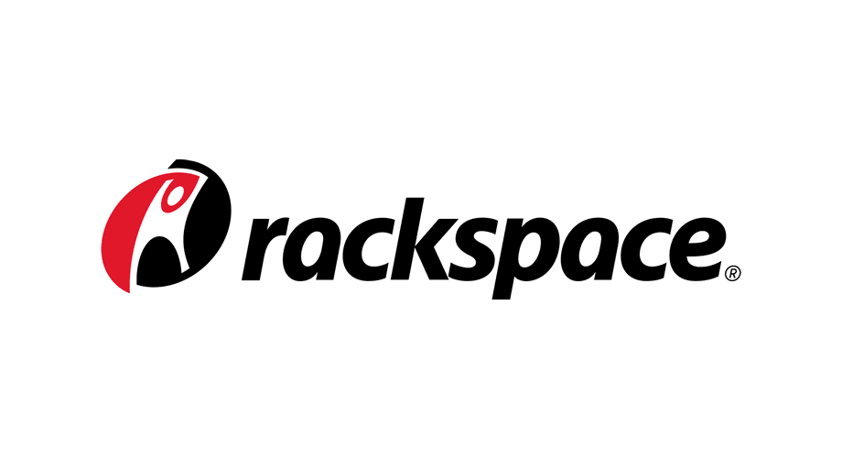
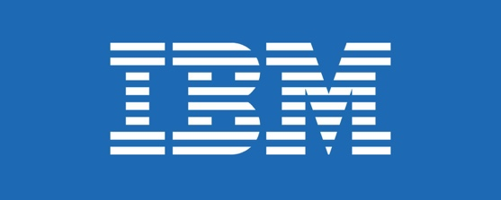

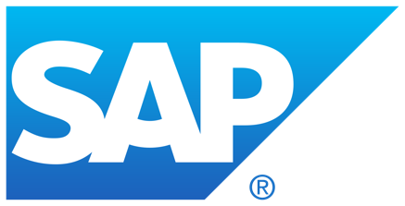

Standing on the Shoulders of Giants
http://stackalytics.com/?release=all&project_type=kubernetes-group&metric=loc&module=kubernetes
Notes:
So companies like these could contribute to it. Now this is just a small swath of the 45 corporate contributors out there, not to mention the independent, individual contributors out there.
To do container management right, it takes a village which is to say to get Kubernetes right, it takes a village!
And to toot our horn once again, Red Hat is the number one contributor to Kubernetes behind Google.
And lastly… BREAKING NEWS… Kubernetes 1.5 released today with alpha support for running application nodes on Microsoft Windows Server, including HyperV containers! Another great representation of the community!

Slide 32
$120,218,331.00
to
Develop Kubernetes
http://thenewstack.io/tns-research-k8s-ecosystem-cost/
Notes:
And to reiterate how much has gone into building the Kubernetes ecosystem, The New Stack did research into the contributions of Kubernetes and calculated the time spent across of these companies and found over 120 million dollars in development costs have been invested up to Kubernetes v1.4.
This is a lot of cheddar for one company to spend on solving container management challenges, which is why the open-source community is such a great fit.

Slide 33
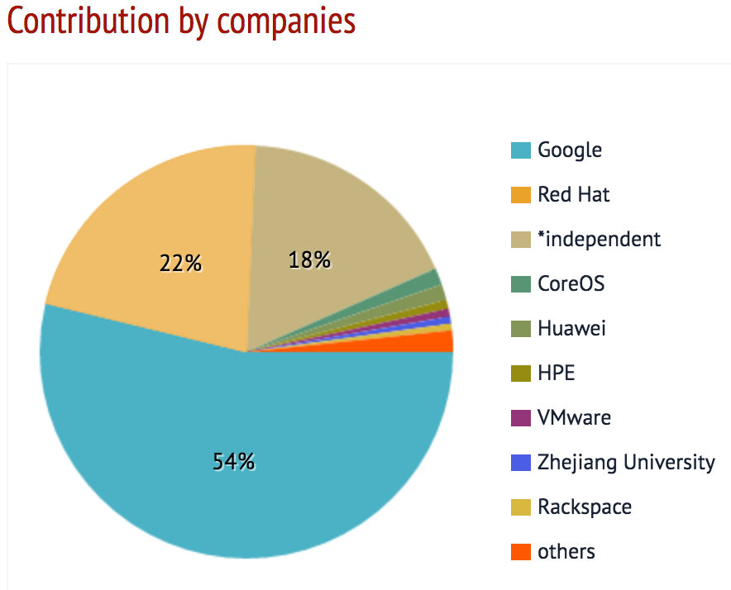
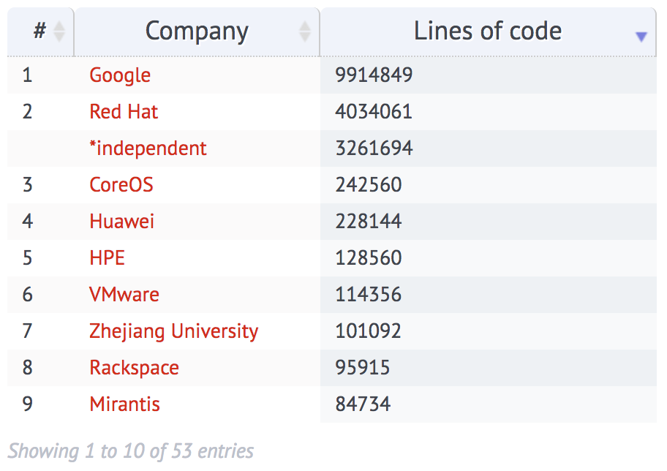
And Red Hat is a Big Part of this!
http://stackalytics.com/?release=all&project_type=kubernetes-group&metric=loc&module=kubernetes

Slide 34
Container Management is TOUGH!
Notes:
And this is to say, if you are going to DIY container management, remember how tough it is to do it right. To build something as enterprise grade as Kubernetes. Are you really going to spend over 120 million dollars on doing this on your own rather than invest in your business mission? I hope everyone on the call answers no to this question.

Slide 35
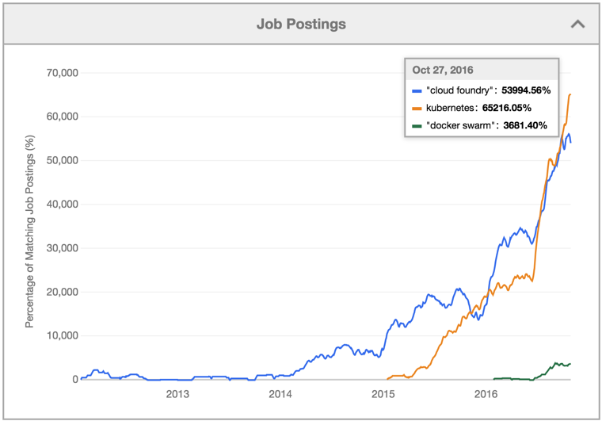
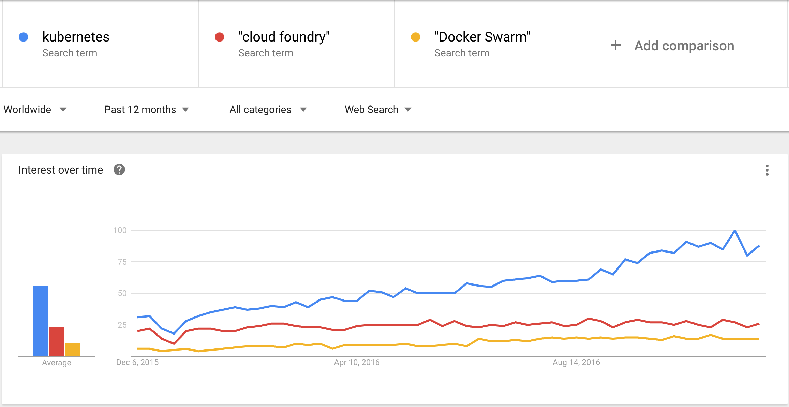
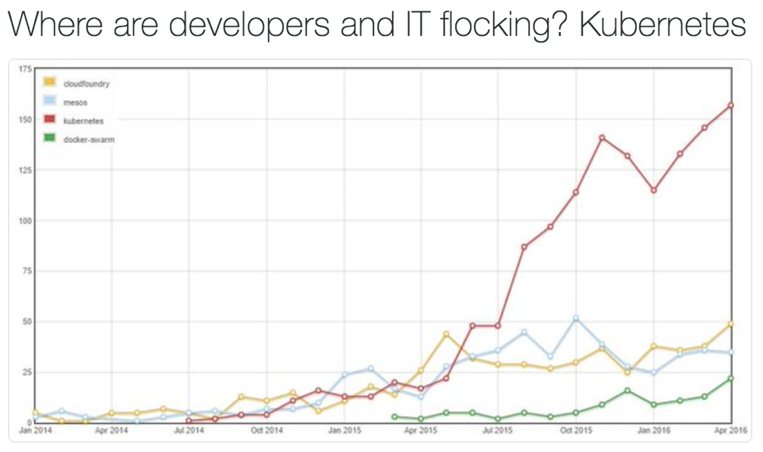
Incredible Velocity
Top 0.01% of Github projects
Over 14K Slack members
https://www.google.com/trends/explore?date=today%2012-m&q=kubernetes,%22cloud%20foundry%22,%22Docker%20Swarm%22
https://twitter.com/Chris_Gaun/status/730035598191427584
https://kubernetes.slack.com/messages/kubernetes-users/
https://apprenda.com/blog/happy-1st-birthday-kubernetes-infographic/
http://www.indeed.com/jobtrends/q-%22cloud-foundry%22-q-kubernetes-q-%22docker-swarm%22.html?relative=1
Notes:
And it’s pretty clear organizations are too and rallying around Kubernetes.
Up on this slide, you’ll see in the upper left the search trends of folks looking for info on how to use Kubernetes. Upper right is job trends and lower left is stack overflow interest.
The velocity Kubernetes interest is super important to the health of the Kubernetes project itself. Remember, a healthy open source community only remains healthy if there is a ton of work and interest being done by multiple orgs and individuals.

Slide 36






















































CNCF: A Community of Innovation
https://www.cncf.io/about/members/
Notes:
And the high velocity of Kubernetes would not be possible without the management of the project by the Cloud Native Computing foundation also known as CNCF.
Per CNCF and its’s founding over a year ago, it’s mission is to create and drive the adoption of a new computing paradigm that is optimized for modern distributed systems environments capable of scaling to tens of thousands of self healing multi-tenant nodes.
[CLICK]
And CNCF is doing this not only with Kubernetes, but Fluentd, a logging solution to unify collection and consumption, open tracing, an open standard for distributed tracing, and Prometheus, a monitoring solution.
[CLICK]
And the involvement is huge. Each of these logos play a big part in sheparding these projects, including Kubernetes, the right way for a true community of innovation, which is super important to a healthy open-source community.
[MODERATOR] "Why is a healthy community so important?”
Because to be truly open-source, you need a good blend of users, contributors, and vendors to make it work. Remember, open source is a meritocracy. No single vendor or contributor should be deciding the complete direction of an open source project, and too often, that is the case. A fully open community of innovation ensure the market decides the direction of project over time, thus future-proofing an organization’s investment in the same.

Slide 37






























Kubernetes, tried and trusted
http://events.linuxfoundation.org/events/kubecon/program/schedule
https://apprenda.com/why-kubernetes
Notes:
And the last note I’ll say on Kubernetes is that many companies have made the leap to using it. Being a man of metaphors, I always like to say ”the second mouse gets the cheese”.
With Kubernetes being so heavily in use, like at the orgs on this slide, you can be ensured your org is in good company in Kubernetes being tried and trusted.

Slide 38
Containers are
great…
but it’s not enough
Notes:
K, so now we have a primer on MSA, I want to circle back on containers and Kube and get into OpenShift.
We’ve established containers are a great utility, but are not enough.

Slide 39
You need container management...
Notes:
That we need container management to actually make containers work for you

Slide 40
The best container management is Kubernetes
but...
Notes:
And that the best container management system out there is Kubernetes

Slide 41
Even Kubernetes is not enough...
Notes:
But…
Even Kubernetes is not enough!

Slide 42

https://twitter.com/brendandburns/status/849371016308588544
Notes:
Gabriel -> CTO of Deis
Brendan Burns-> Kube co-founder
https://twitter.com/brendandburns/status/849371016308588544

Slide 43
You need a great platform to focus on your mission in building great apps and delivering value!
Notes:
You need a great platform to focus on your mission by delivering great app and huge business value.
In other words we need a platform to make Kubernetes boring.

Slide 44
The best platform is OpenShift
Notes:
And the best kubernetes platform to do this, is Red Hat OpenShift.

Slide 45

OpenShift is Enterprise Ready Kubernetes
and a whole lot more
Notes:
Red Hat OpenShift is Enterprise-Ready Kuberetes and a whole lot more. And that whole lot more is what we are going to talk about.
[MODERATOR] "What does it mean to be 'enterprise-ready' Kubernetes?”
This means to provide an easy button to the awesomeness of Kubernetes, to abstract away the complexity of Kubernetes and add some special sauce to make it easier to build and deliver great apps, get business value deployed, and make it more usable from on operations perspective.
Also, the Kubernetes community releases quickly. Red Hat does a great job of testing hardening these releases, always contributing fixes back to the upstream. Additionally, Red Hat provides support top to bottom for everything in OpenShift, including Kubernetes and the container tech so you have someone to call and as I like to say, one throat to choke or one body to hug, depending on how we are servicing you.

Slide 46
What is your Kubernetes strategy?
Notes:
So in addition to your “what is your Kubernetes strategy”

Slide 47
What is your Building Great Apps strategy?
Notes:
We want to ask “what is your building great apps strategy”?

Slide 48
Kubernetes
ORCHESTRATION
STORAGE
Notes:
And to do this the right way, in a state of DevOps where your org focuses on business results more so than technical details, you need more than what Kubernetes provides by itself.
Now this is not to say the orchestration piece is small potatoes, b/c it’s definitely not, especially given the over 120 million dollars invested in it.

Slide 49
OpenShift
Red Hat Application Services (JBoss)
Business Automation
Integration
Data
Web & Mobile
3rd party frameworks
CONTAINER
CONTAINER
CONTAINER
CONTAINER
CONTAINER
LIFECYCLE AUTOMATION
CONTAINER MANAGEMENT
PaaS
SELF-SERVICE
SERVICE CATALOG
MONITORING
CAPACITY MGMT (CloudForms)
PUBLIC REGISTRY (RH Registry)
Red Hat OpenShift Container Platform (incl. CloudForms)
CI/CD (Jenkins)
IMAGE BUILD
POLICY MANAGEMENT (CloudForms)
SECURITY ANALYSIS (CloudForms)
OPS MANAGEMENT (CloudForms, Satellite)
CaaS
CONTAINER INFRASTRUCTURE SERVICES
ORCHESTRATION (Kubernetes)
CONTAINER ENGINE (Docker Engine)
REGISTRY (Atomic Registry)
OPS AUTOMATION (Ansible)
STORAGE (Kubernetes)
SECURITY (Docker Engine)
NETWORKING (Open vSwitch)
STORAGE (RH Storage)
Red Hat Enterprise Linux & Atomic Host
ENTERPRISE-GRADE CONTAINER OS (Red Hat Enterprise Linux & Atomic Host)
IaaS
DEV TOOLS ( Developer Studio, Container Dev Kit)
PHYSICAL VIRTUAL PRIVATE CLOUD PUBLIC CLOUD
Notes:
But you need a lot more to just deliver business value.
And as you can see here, the “special sauce” Red Hat adds a whole lot in addition to upstream Kubernetes and docker.
And the thing is, each of these boxes are definitely needed to be an enterprise-ready platform. Things like security, monitoring, CI/CD, self-service, policy management and more have to be bolted on to Kubernetes so you can focus on your mission rather than an org expending resources on bolting these things on and supporting them after. In other words, Red Hat provides what you need so you don’t spend big bucks rolling your own kubernetes-based platform.

Slide 50

OpenShift Features
Notes:
Expanding on this and the major features of OpenShift are things like self service… the ability for developers to deploy code and operators to set policy through APIs, rather than manual minutia…
And multi-language… OpenShift is totally polyglot to support any workloads that can run in a docker container; Remember the COBOL example?
And automating out manual processes bogging down traditional IT, permitting full swaths of teams to collaborate on projects in private and shared spaces like never before.
And OpenShift is standards-based, not just in terms of its components like docker and Kubernetes, but in terms of operations… Operation teams and architects define policy and OpenShift provides the governance to ensure these standards are represented in every application and service deployed.
Web Scale… OpenShift’s ability to run large scale, mission critical workloads on any number of infrastructure… in your data center, in the cloud, or in both…
And I’ll stomp it again… everything in OpenShift is 100% open source, accelerating innovation and absolutely hockeysticking in terms of features.
Lastly, OpenShift is enterprise grade. All bits are fully tested, certified, and supported by Red Hat for the most important of workloads

Slide 51

The BLUF OpenShift Value
Built for both traditional and cloud-native applications
An integrated hybrid cloud application platform for application development and deployment
Easily turn source code into running applications with source-to-image capabilities
Develop, build, and manage applications in containers, without having to focus on building containers
Notes:
The business value BLUF of OpenShift is the DevOps platform for both traditional and cloud-native apps running on all types of infrastructure, to put your code into production, without having to focus on immense technical details, including the containers themselves, made possible by one of my favorite OpenShift features, “Source to Image”.

Slide 52

Making this Conversation Extinct!

Slide 53




10,000 Foot View of OpenShift
Notes:
To get into the weeds a bit, the thousand foot view of what makes everything happen looks like this.
First, let’s start with the nodes… these are the boxes actually hosting the applications and services your developers deploy in logical units, defined by a Kubernetes primitive called Pods… these are a logical unit binding one of more containers together with shared fates, including scheduling and lifecycles. There’s more on this, but for now, let’s just talk pods being synomonous with containers and apps.
Next, the Masters, which are a set of infrastructure services, serving as the integration point for developers and operators, providing security, live data storage, container scheduling and management, and replication to the nodes and the service layer…
The service layer serves as discovery and registration for the payloads running on the nodes, acting as a logical marshalling point for multi-instance applications, also known as horizontally scaled apps.
In addition to inter app communications, the service layer services requests from the routing layer which provides access to apps and services from outside the OpenShift cluster.
To the right in the diagram, you’ll see persistent storage, which is easily mountable into nodes and applications to support things like stateful apps and services such as databases.
You also see the registry component, which is critically important as it stores and supplies the policy set by operators and architects and the builder images and versioned containers for smooth operation of the platform.
[CLICK]
Lastly, OpenShift runs anywhere RHEL runs, including most public and private cloud infrastructures. And this is great from a security standpoint because since OpenShift runs on RHEL, it inherits the all the security C&A that RHEL has baked in!

Slide 54


SKMM
Characteristics
Examples
 | Lift and Shift to rkt, docker, etc | Anything in Docker Hub, WebSphere, WebLogic, traditional apps, etc
 | Liveliness and Readiness Probe aware and more | Java, .Net Core, Node.js or Spring Boot app w/ healthz implemented
 | Designed from the ground up with Kubernetes in mind | Crunchy PostgreSQL Container Suite, EDB, Kafkanetes
 | Takes full advantage of OpenShift features | S2I and xPaaS applications, both traditional and next-gen, OpenShift Primed
Tier 1
OCI Ready
Tier 2
Kubernetes Ready
Tier 3
Kubernetes Native
Tier 4
OpenShift Native

Slide 55

SKMM – Tier 3 – Crunchy DB

Slide 56
SKMM
Characteristics
Examples
 | Lift and Shift to rkt, docker, etc | Anything in Docker Hub, WebSphere, WebLogic, traditional apps, etc
 | Liveliness and Readiness Probe aware and more | Java, .Net Core, Node.js or Spring Boot app w/ healthz implemented
 | Designed from the ground up with Kubernetes in mind | Crunchy PostgreSQL Container Suite, EDB, Kafkanetes
 | Takes full advantage of OpenShift features | S2I and xPaaS applications, both traditional and next-gen, OpenShift Primed
Tier 1
OCI Ready
Tier 2
Kubernetes Ready
Tier 3
Kubernetes Native
Tier 4
OpenShift Native

Slide 57
SKMM – Tier 4 – Fuse

Slide 58
OpenShift is the new school RHEL

Slide 59
Monolith vs SOA vs Microservices
Monolith
SOA
Microservices
Notes:
So now that I hopefully have you convinced on the merits of the experience going into Kubernetes and the community surrounding it, I want to switch gears a bit to talk about microservice architecture, also known as MSA.
First list start with monolithic arch, which is basically a bunch of functions living in the same app container. I’ve represented these functions with the little gears you see. The thing about the “app container” in this context is that when functions are grouped together, they share fates. This means that if one function is unhealthy or one function exhausts the whole of the resources or if one function’s security is compromised or if we need to scale out with demand or if we need to deploy, it affects all functions in the monolith. It’s also worth noting that monolithic design does not necessarily promote reuse of functions by other apps.
Moving to the right, we see Service Orientated Architecture. This is still pretty big where we break functions out into smaller chunks and service-er-rize them for re-use. This is the 2nd tier in what most think of a 3-tier app. From a shared fate perspective, this is definitely better than a whole monolith, but still has room for improvement.
And this is where the microservice movement comes in. Each function is in it’s own, independent app container, each having it’s own fate. This is where you see a lot of talk around modern app development.

Slide 60
Monolith Deployment
Router
Notes:
There are tons of benefits and challenges in doing MSA, and I want to touch on two of them now: Deployment and scaling.
First on scaling. Let’s say the business sponsor in the upper left wants to deploy new features in two functions of a monolith.
[CLICK]
Version two of the red and green functions are deployed in the whole of the monolith.
[CLICK]
But we find that red has a bug in it.

Slide 61
Monolith Deployment
Router
ROLLBACK
Notes:
So then we have to rollback EVERYTHING, including what was actually working in the green function.
This leaves for a unhappy business sponsor b/c he/she cannot get ANY new functionality out and unhappy users who were expecting a new experience.

Slide 62
Microservices Deployment
Router
Notes:
Let’s compare this to deployment in MSA. But first of all, you’ll notice there are still some monoliths there. This is because orgs usually cannot do a full re-write of monolith apps from scratch. What usually happens, and what Red Hat recommends a lot of the time, is to start chipping away at monoliths as functions need to change and scale independently. Basically, just start decomposing your app down.
K, so similarly to what we just showed in the monolith example, our business owner wants to deploy new versions of the red and green functions.
[CLICK]
We deploy,
[CLICK]
But during deployment, we discover the red version doesn’t work

Slide 63
Microservices Deployment
Router
ROLLBACK
Notes:
And needs to be rolled back. Well, in MSA we can do this and not effect the green function because they don’t share fates.
You business sponsor probably isn’t happy, but he isn’t mad either because at least some of the new functionality got out.

Slide 64
Monolith scaling
Router
Notes:
Now to scaling, which I think is probably one of the more important benefits of MSA.
But first, lets look at monolith scaling.
Let’s say your users are hitting the red and green functions heavily, but not using the other three functions at all.
[CLICK]
As the demand increases, your monolithic app must scale out to increase capacity. But because of shared fates, resources are consumed for all five functions rather than just for the two functions that need to add more capacity.
[CLICK]
Well, this lack of density exhausts your resources very quickly, thus you cannot service all of your users, making for a bad experience and unhappy users.

Slide 65
Microservice Scaling
Router
Notes:
Microservice on the other hand are different.
Because each function is independent,
[CLICK]
Each function can scale by itself, making a much more dense deployment, not exhausting your resources and providing a great experience for your users, even as demand spikes.

Slide 66



Builder Images and Templates Explained
Assembler
Run Script
Build Config
Like CA or Nagios
Agents?
Deployment Config
Like Spring or Node.js
Other Libs
Parameters
Like Tomcat or EAP
MW
Routes
Like RHEL
Base OS
Builder Image
Template
Notes:
Okay, remember how I said OpenShift enables shops to deliver applications in a containerized world without having to really focus on containers because of the Source to Image feature? Well, I’d like to explain how this works through OpenShift Builder Images and Templates
This all begins with an admin starting with a base OS image, hopefully one provided by Red Hat’s container registry which are safe and secure images, especially when compared to the wild west of docker hub, provided by Red Hat.
[CLICK]
Next middleware,
[CLICK]
Other libs including development framework dependencies,
[CLICK]
And even agents are layered on as something we call ”image streams”.
[CLICK]
Then your admin defines how your developer’s app code should be assembled and inserted into the builder image
[CLICK]
And the command that turns the app on.
[CLICK]
Finally, an admin defines a template which is the policy on how the app is built, how it’s deployed, what parameters, like db strings, etc, are required to inserted, and how the app is routed to by external apps. This is also where app security policies, deployment pipelines, scaling policies, quotas, telemetry, and other configs are centerally defined.

Slide 67

How an App Gets Pushed to OpenShift
BNode
ApReg
templ:java
Master
BI Reg
ANode
ANode
Notes:
And this is how developers take advantage of this. How to develop and deploy an app without having to focus on building containers.
So first of all, your developer developers their app traditionally in whatever they’re comfortable with.
[CLICK]
Then, they push their app to openshift, defining their template name they want to use that the admins have supplied in the OpenShift cluster registry.
[CLICK]
The master requests the java Builder Image and Template which is based on tomcat
[CLICK]
Then the master ships the the app package and BI to a builder node where the app bits and BI are combined
[CLICK]
This then gets shipped to the Application Registry where it is signed immutable
[CLICK]
And gets deployed to application nodes and is now exposed for use.

Slide 68



CI/CD Pipelines in OpenShift
Notes:
Taking this a step further, OpenShift has a really cool build pipeline feature powered by Jenkins.
In this case,
[CLICK]
The developer checks their code into git,
[CLICK]
Which kicks off a build in Jenkins, linked to and leveraging build images, builder nodes, and templates
[CLICK]
That then kicks off automated tests, delivering results to the PM and Dev Manager,
[CLICK]
Which then gets a security scan by Blackduck, with a security report delivered to the IA team
[CLICK]
And finally gets a manual approval through a change action board
[CLICK]
And an app certified and guaranteed to go through all these steps are deployed to OpenShift app nodes.
[CLICK]
Which is a celebration to all.
http://stackoverflow.com/questions/31076928/kick-off-a-job-after-manual-approval-in-jenkins
Promotions plugin

Slide 69

CI/CD Pipelines in OpenShift
Notes:
And here is an actual screenshot from OpenShift where we demoed this process.
And you’ll see at one build, the unit tests failed. And that’s right, if the tests failed, or any other step in the pipeline does, the new build does not go out!
[MODERATOR] "These pipelines seem very advanced and only for mature shops. Do you HAVE to use them to adopt OpenShift?”
No, not at all. This is definitely more of a nirvana girl There are many deployment strategies, including blue/green, canary, and simple binary pushes, offered in OpenShift and pipelines is just one of them. Now I will say the previous example is actually in use by one of our customers, but in this case, they were pretty advanced in having a mature pipeline established.

Slide 70






Heterogeneous Environment w/o a Platform
Notes:
And what is great about OpenShift source to image and this pipeline paradigm is that it prevents developers just going out to dockerhub, picking an image, and deploying containers in the raw… a real wild west can form… which we’ve seen in lots of different IT shops
For example, take a developer that wants to
[CLICK]
Deploy spring
[CLICK]
Then Node.js
[CLICK]
Then Tomcat
[CLICK]
Then Ruby
[CLICK]
And more
[CLICK]
And how about when deploying multiple versions of the same framework? From an operations perspective, this is extremely difficult to manage and is costly.

Slide 71


Heterogeneous Environment w/ OpenShift
BI Reg
Notes:
In OpenShift world, because of Source to Image, this cannot happen.
[CLICK]
Let’s say a developer pulls a docker image from docker hub
[CLICK]
Tries to deploy but is stopped by openshift
[CLICK]
Instead, the developer builds his app in the tomcat builder image certified and living in the openshift image registry
[CLICK]
And deploys the app, taking with it all the security, policy, and other configs that have been defined by admins.
[CLICK]
Same goes for whatever the admins have put into the BI reg ”toolbox” as I sometimes like to call it

Slide 72

Logging w/o a Platform
Notes:
Next lets talk about something really important once apps get deployed, and that is monitoring.
In the microservices world, each function runs on its own.
[CLICK]
And produces it’s own logs… which means there are a TON of them, compared to what was produced using monoliths.
[CLICK]
So, when logs need to be reviewed
[CLICK]
It’s a very arduous, manual task, which ends up really being a pain

Slide 73


Logging w/ OpenShift
Notes:
In OpenShift, we take care of this fore you.
We put FluentD, the open source collector from CNCF on each node
[CLICK]
Which collects and transfers logs to be stored and indexed in elastic search.
[CLICK]
And on a larger scale, the benefits of automating this is even more evident.
[CLICK]
So when the logs need to be reviewed
[CLICK]
Your folks just go to one place, Kibana. And yes, this is all provided by and supported by Red Hat.
And I do know that a lot of orgs have invested in a solution like Splunk
[CLICK]
Cool thing is, the logging framework in OpenShift is pluggable. Also, I realize some folks may think this isn’t special in that I can just build and add my own logging solution to Kubernetes. While this is true, remember, logging is a technical detail you shouldn’t have to worry about it. You wan’t get to a state of DevOp with adhoc automation. Red OpenShift gives you everything you need in a turnkey package.

Slide 74


Patching Apps w/o a Platform
Notes:
K, now to something even more arduous in a containerized, MSA arch… patching
For this, I’ll use something recent…
[CLICK]
Let’s say dirty cow is across a certain app, which in the containerized, MSA world equates to
[CLICK]
Manual patching by ops, which is slow and error-prone… yes, even with adhoc automation via chef or puppet or similar.

Slide 75
Patching Apps w/ OpenShift
Notes:
Patching in OpenShift is completely different. We start again with Dirty Cow

Slide 76
Remember the Builder Images?
Agents?
Other Libs
MW
Base OS
Builder Image
Notes:
But instead of patching each individual app instance,
[CLICK]
The operator patches the image stream in the BI that needs it, in this case, the base OS layer

Slide 77
Remember how Apps Get Pushed?
BNode
ApReg
Master
BI Reg
ANode
ANode
Notes:
This patched version,
[CLICK]
Is then pushed to the master
[CLICK]
Which is then put into the BI reg
[CLICK]
And pushed to the builder node,
[CLICK]
Along with ANY original app packages that leverage this BI. Then the build kicks off, which may actually be a pipeline build to include all the automated testing, scans, approvals and such to guarantee the new image stream in the builder image did not break anything.
[CLICK]
Then the newly created, dirty cow free, app image is pushed to the app reg
[CLICK]
And redeployed across the cluster

Slide 78
Patching Apps w/ OpenShift
Notes:
Which looks like this.

Slide 79
Bits Scanned and Secured to Prod
DEV
QA
PROD
Notes:
And coming back to the security posture, these apps that were built, tested, scanned, and signed,
[CLICK]
Move from Dev to QA,
[CLICK]
From QA to Prod, each injected with environment specific parameters, with a guarantee nothing has changed since it went through its process since dev.
[CLICK]
And this is great from a portability perspective out to other environments compatible with the container spec.
[MODERATOR] "So basically you are saying that the stuff you develop on OpenShift, can go to other container environments?”
Exactly!

Slide 80
High Availability in OpenShift
ApReg
Master
Liveliness Probes
Readiness Probes
ANode
ANode
Notes:
The last major OpenShift concept I want to talk about is HA, which is totally automated in OpenShift and can be guaranteed at the app, host, rack, and AZ level.
So first, lets say an app goes unhealthy
[CLICK]
This is signaled by an app’s readiness probe telling OpenShift it’s not healthy. A readiness probe in a custom endpoint developers or admins implement to tell OpenShift an app is not in it’s desired state.
[CLICK]
Each app node signals the masters that there’s a problem
[CLICK]
The masters review
[CLICK]
Masters kill the unhealthy app instances
[CLICK]
Notifies there is an actual state change compared to the desired
[CLICK]
And deploys out a working instance to the app nodes. The apps are only then routed to when their readiness probes, another Kubernetes Primitive, signal the app is ready to service requests.

Slide 81
The Best Lesson I Ever Received
Chuck, the toughest challenges you will ever face in IT, are people
-Mark Zukas
My old boss at Asurion

Slide 82
People Management is TOUGH!
Notes:
Remember what I said? It’s HARD. You are not going to out container manage Kubernetes with Swarm or anything else. There are just too many contributors to keep up!

Slide 83

Developers be Like

Slide 84

Operators be Like
* Courtesy of Drew Sheneman, Tribune Content Agency

Slide 85

Execs be Like

Slide 86
Roles to Run OpenShift
Container
Builders
Developers
Operators
Write Code
Write Tests
Implement Instrumentation
Field MW/Lib Reqs
Implement Policy
Build BIs & Tmpl
Test BIs & Tmpl
Deploy BIs & Tmpl
Patch BIs
Define CI/CD Pipelines
Define Instrumentation
Deploy RHEL
Patch RHEL
Deploy OpenShift
Patch OpenShift
Define Policy
Deploy Policy
Approve BIs
Notes:
And the container builders are also patching BIs according to the policies and guidance set by the operators
[CLICK]
In summary, these specific, yet with excellent feedback loops, roles are the way to make OpenShift and DevOps sing in your org.
[MODERATOR] "Where do the container builders come from? Are orgs gonna have to hire new people for this?"

Slide 87

OpenShift Checks and Balances
Generate Demand
Supply Tools
Request Tools
Prohibit Raw Container Deploys
Deploy BIs
Define Policy
Notes:
So let’s take these roles and put them into a ”checks and balances” view
[CLICK]
Developers generate demand for the platform because they are delivering apps faster than they ever could
[CLICK]
While operators provide control on the platform so developers can deliver apps safely and securely
[CLICK]
Developers also request new tools from the container builders so they can innovate with the latest and greatest
[CLICK]
In return, container builders supply tools in the form of builder images that contain all of pipelines, deployment strategies, security, policies etc for developers to build apps in
[CLICK]
Realizing now this is a bit out of order here, but the operators are defining policies outlined in the previous step
[CLICK]
And the Container builders are implementing the operators vision by building and deploying BIs for use by the developers
[CLICK]
And all of this is made possible by the automations and governance provided by Red Hat OpenShift

Slide 88
How to do It
Discover a compelling event
Find the executive to sponsor you with encouragement and money
Agree to not be afraid of change
Empower your top innovators and change agents
Educate your dissenters
Start small; do not boil the ocean
Understand it’s okay to fail, but fail fast
Call Red Hat to help motivate your people
Get involved in the community!

Slide 89

OpenShift Commons
An interactive community for all OpenShift PaaS Users, Customers, Contributors, Partners, Service Providers and Developers to share ideas, code, best practices, and experiences.
Notes:
And with OpenShift, there is a great way to get involved with the community.
OpenShift Commons is an interactive place for OpenShift Users, Customers, Contributors, Partners, Service Providers and Developers to collaborate with Red Hat and other participants to share ideas, code, best practices, and experiences… remember community is a huge reason why open source is so awesome. And in my opinion, if you are not involved beyond use in the open source community, you’re not getting all out of it as you could.

Slide 90
Building a Platform
is TOUGH!
Notes:
Remember what I said? It’s HARD. You are not going to out container manage Kubernetes with Swarm or anything else. There are just too many contributors to keep up!

Slide 91







Open Source
Open Source

Slide 92






Supported Open Source

Slide 93
A Complete DevOps Solution
OpenShift
+
Training
+
Professional Services
+
Open Innovation Labs
Notes:
Remember what I said? It’s HARD. You are not going to out container manage Kubernetes with Swarm or anything else. There are just too many contributors to keep up!

Slide 94

A Complete DevOps Solution
https://www.redhat.com/en/explore/my-open-innovation-lab-stack
Notes:
Remember what I said? It’s HARD. You are not going to out container manage Kubernetes with Swarm or anything else. There are just too many contributors to keep up!

Slide 95
What next?
Web
kubernetes.io
cncf.io
openshift.com
developers.redhat.com
katacoda.com/courses/kubernetes
openshift.katacoda.com
Twitter
@KubernetesIO
#Kubernetes
@CloudNativeFdn
@OpenShift

